Slide 1
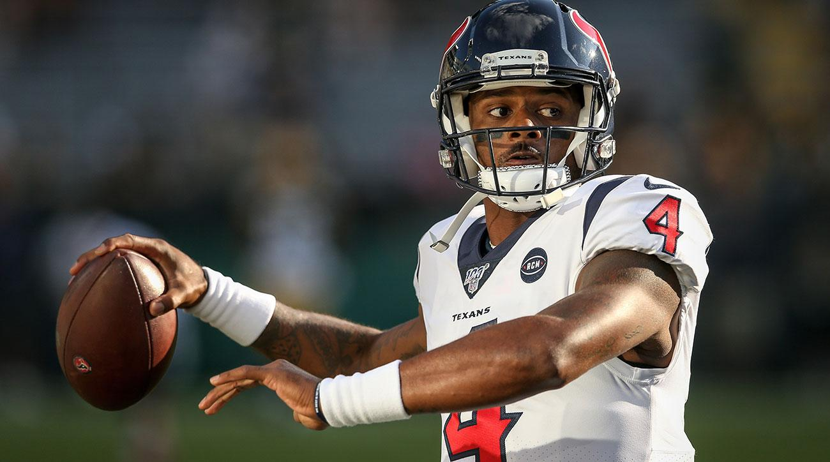

Fantasy Football Database
DAT 200 Final Project (Fall 2019)
By Jonathan Wiseman, Jeremy Eberly,
Steven McAlpine, and Brock Culver

Slide 2
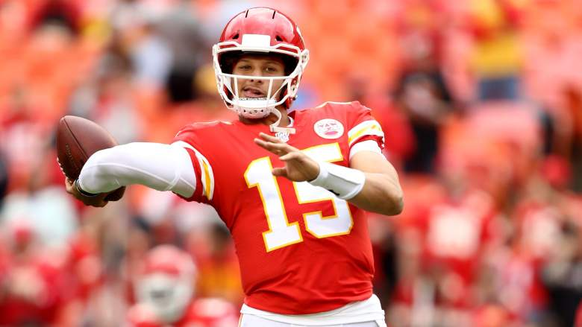
Introduction

Slide 3
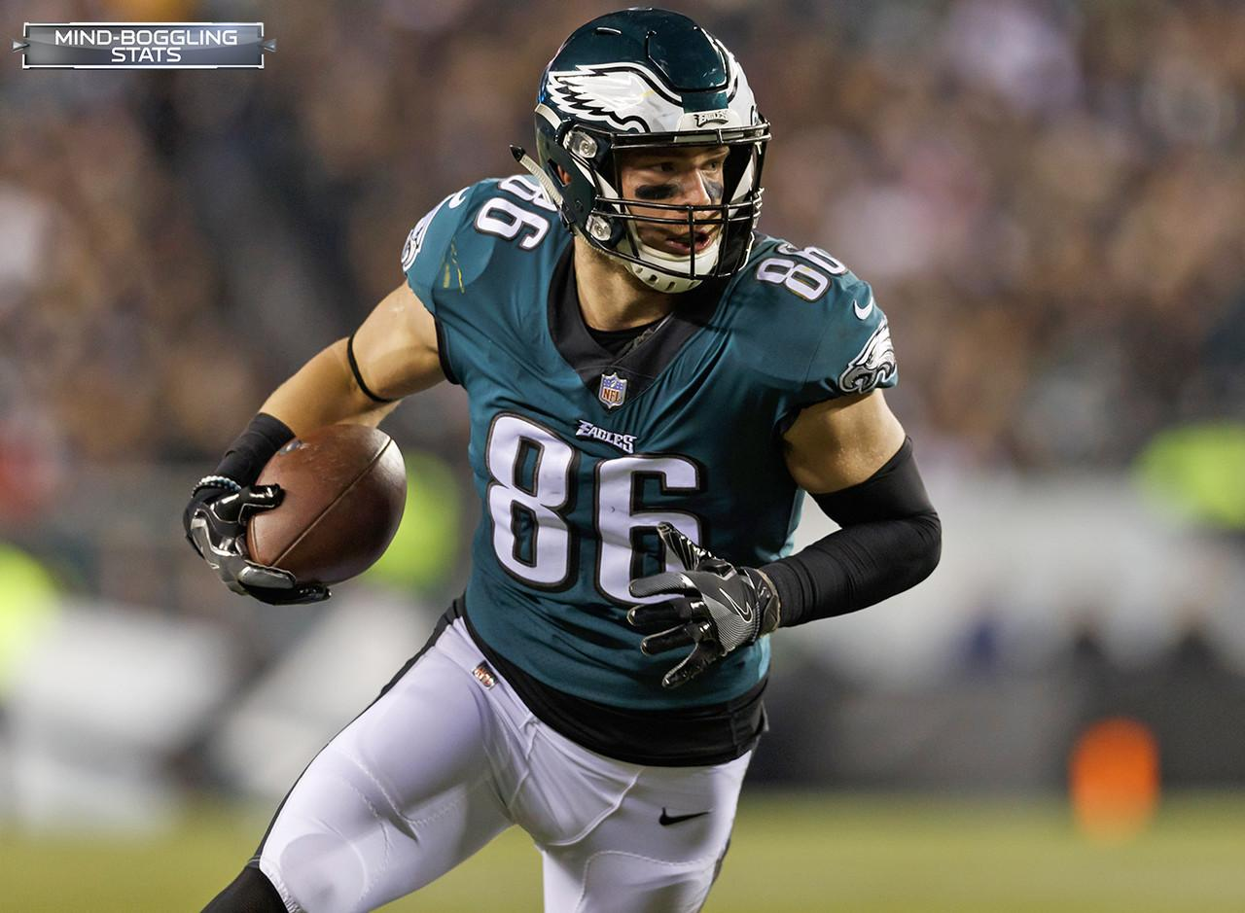
Motivation
Fantasy football is a game based on American football
Players serve as managers of digital football teams consisting of real-world players
A team in a fantasy league competes against one other team each week
Points are derived from the performance of the real-world players on each fantasy team

Slide 4
Fantasy Football Rules
For the sake of this project, the rules were made extremely simple. Each team consists of:
1 QB
2 RBs
2 WRs
1 defense (special teams omitted)
for a total of 6 “players”

Slide 5
Fantasy Football Rules (cont.)
Scoring on offense:
1. 1 point per 25 passing yards
2. 1 point per 10 rushing yards
3. 1 point per 10 receiving yards
4. 6 points for a touchdown
5. -2 points for an interception
Scoring on defense:
1. 1 point per sack
2. 2 points per safety
3. 6 points per touchdown
4. 2 points per kick/punt block
5. 2 points per interception

Slide 6
Terminology
Mixing football and fantasy football terminology can be confusing. Here’s an explanation of some of the terms we use:
User: participant in a fantasy league
League: a fantasy league consisting of many teams
Contract: “ownership” of a player by a user’s team
Score: fantasy points scored by players according to scoring rules
Free agent: a player that is not under contract with a fantasy team

Slide 7
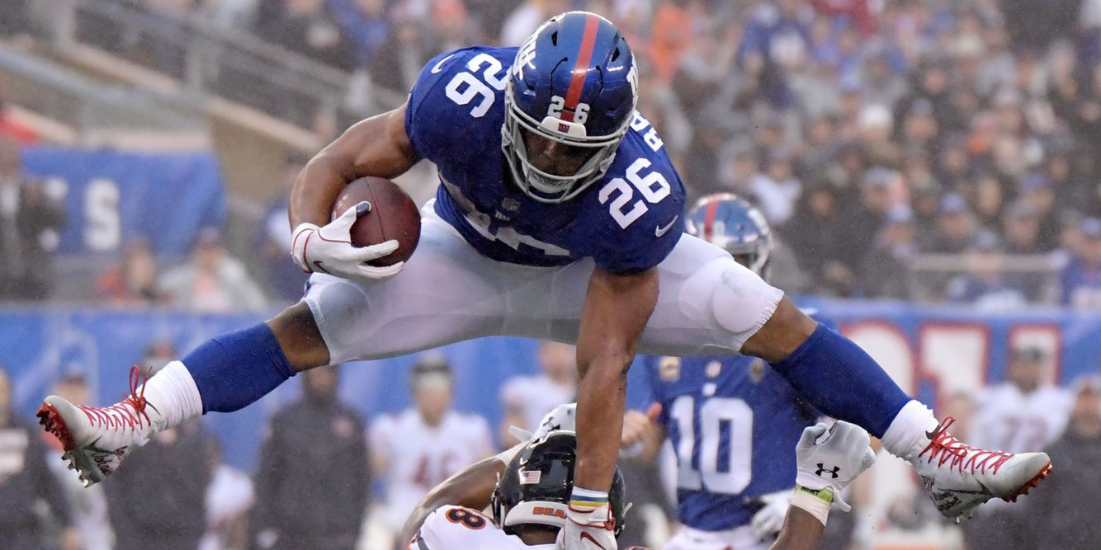
Major Goals of
Fantasy Football Database
List all currently active players in a given league
Display all of a user’s created teams
Display the total fantasy score of a team’s players for a given week
Simulate a matchup between two teams in a given week
View free agents at a given position in a specific league

Slide 8
Considerations for ERD Design
Offense and defense should be separated
Don’t use the same statistics: e.g. offensive players don’t have sacks recorded
One user can manage multiple teams in different leagues
Players can be traded between teams
Need to include a start and end date for each contract
Not all players on a team are active at the same time
Need to be able to activate and deactivate contracts
Need to keep track of players that are NOT under contract (i.e. free agents)

Slide 9
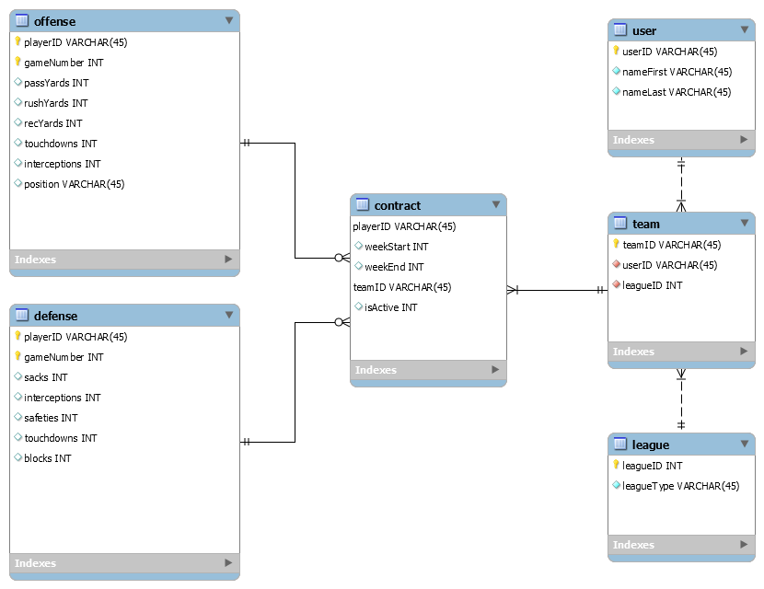

Entity Relationship Diagram (ERD)

Slide 10
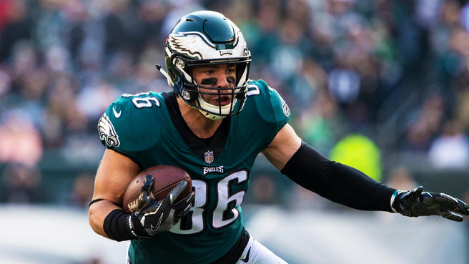
Entity Summary

Slide 11
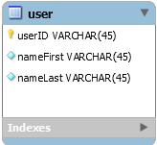
User
Keeps track of each user’s personal information
Relationships:
One user can manage many teams (since each team can be in a different league)

Slide 12
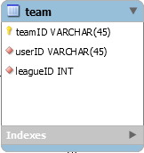
Team
Keeps track of user’s team of players through contracts
Relationships:
Interacts with Offense and Defense tables through the Contract table.
The user’s team belongs to a league.
The team includes many contracts and is owned by one user.

Slide 13
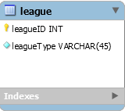
League
Keeps track of each league’s information
Relationships:
One league contains many teams

Slide 14
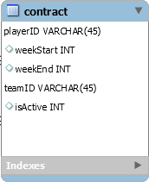
Contract
Keeps track of active contracts between teams and players
Relationships:
Each contract belongs to exactly one team
Each contract is made with exactly one offensive player or defense

Slide 15
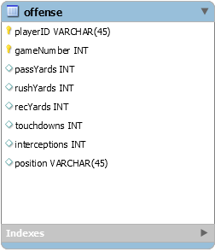
Offense
Keeps track of offensive statistics by player for each week
Relationships:
Each offensive player can be under many contracts
A player might not be under contract at all (optional)

Slide 16
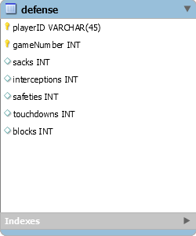
Defense
Keeps track of defenses for each week
Relationships:
Each defense can be under many contracts
However, a defense does not have to be under contract (optional)

Slide 17


Sample Queries

Slide 18
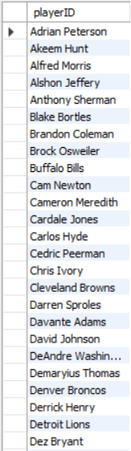
List all currently active players in League 1
SELECT distinct c.playerID
FROM contract c join team t
ON (c.teamID = t.teamID)
WHERE t.leagueID = 1;

Slide 19

Display all of a user’s created teams
SELECT teamID
FROM team
WHERE userID = (SELECT userID FROM user WHERE nameFirst='Thomas' AND nameLast='Garcia');

Slide 20

Display the total fantasy score for a team in a given week
SELECT SUM(o.passYards/25) + SUM(o.rushYards/10) + SUM(o.recYards/10) + 6*SUM(o.touchdowns) -2*SUM(o.interceptions) AS "Offensive Score",
SUM(d.sacks) + 2*SUM(d.safeties) + 6*SUM(d.touchdowns) + 2*SUM(d.blocks)*2*SUM(d.interceptions) AS "Defensive Score",
SUM(o.passYards/25) + SUM(o.rushYards/10) + SUM(o.recYards/10) + 6*SUM(o.touchdowns) -2*SUM(o.interceptions) +
SUM(d.sacks) + 2*SUM(d.safeties) + 6*SUM(d.touchdowns) + 2*SUM(d.blocks)*2*SUM(d.interceptions) AS "Fantasy Score"
FROM contract c LEFT OUTER JOIN offense o
ON (c.playerID = o.playerID AND o.gameNumber=10)
LEFT OUTER JOIN defense d
ON ( c.playerID = d.playerID AND d.gameNumber=10)
WHERE c.teamID='Team0';

Slide 21

Simulate a matchup between two teams (and return the winner)
select c.teamID as "Winner", sum(o.passYards/25) + sum(o.rushYards/10) + sum(o.recYards/10) + 6*sum(o.touchdowns) -2*sum(o.interceptions) +
sum(d.sacks) + 2*sum(d.safeties) + 6*sum(d.touchdowns) + 2*sum(d.blocks)*2*sum(d.interceptions) as "Fantasy Score"
from contract c left outer join offense o
on c.playerID = o.playerID and o.gameNumber=10
left outer join defense d on c.playerID = d.playerID and d.gameNumber=10
where c.teamID='Team0' or c.teamID='Team1'
group by c.teamID
order by 2 desc
limit 1;

Slide 22
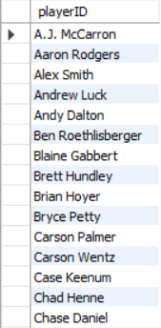
View free agents at a given position in a specific league
select distinct playerID
from offense
where playerID not in (select playerID from contract where teamID in (select teamID from team where leagueID = 1))
and position = 'QB';

Slide 23
Questions?
You can view more queries and data sources at: https://github.com/jonwiseman/DAT200

